Slide 1
Agenda
The teaching team
Contemporary applications of AI
AI-based disasters
Course policies

Slide 2

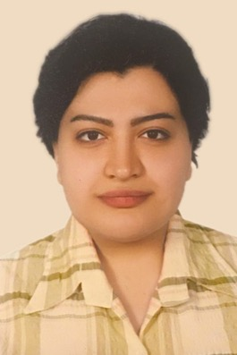

David Grant
Sophie Heidarifar
Schuyler Sturm
Instructor
Teaching Assistants

Slide 3

David Gray Grant, Ph.D.
Assistant Professor of Philosophy at UF
Research focuses on ethics of AI/data science
david.grant@ufl.edu
Office hours Tue/Thu 12:30-1:30 and by appointment
Office: Griffin-Floyd 115C

Slide 4
Sophie Heidarifar
Schuyler Sturm
Teaching Assistants
Notes:
Have TAs introduce themselves

Slide 5
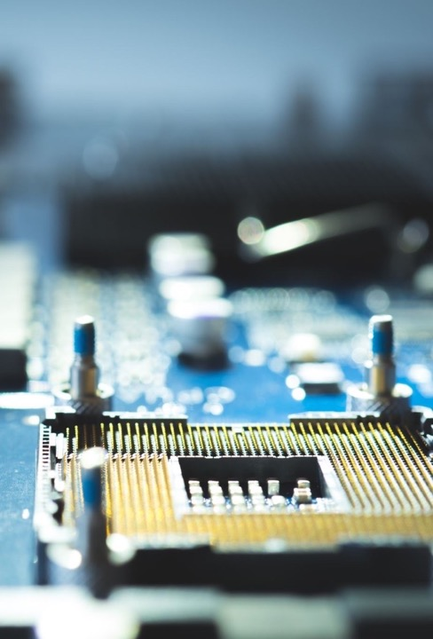
PHI 3681: Ethics, Data, and Technology
Topic: how should emerging technologies be designed and regulated?
Focus: automated systems based on AI
Notes:
This is an ethical question: it’s a question about what we ought to do

Slide 6
Agenda
Introductions
Contemporary applications of AI
AI-based disasters
Course policies

Slide 7
AI is everywhere
Notes:
AI is everywhere now

Slide 8
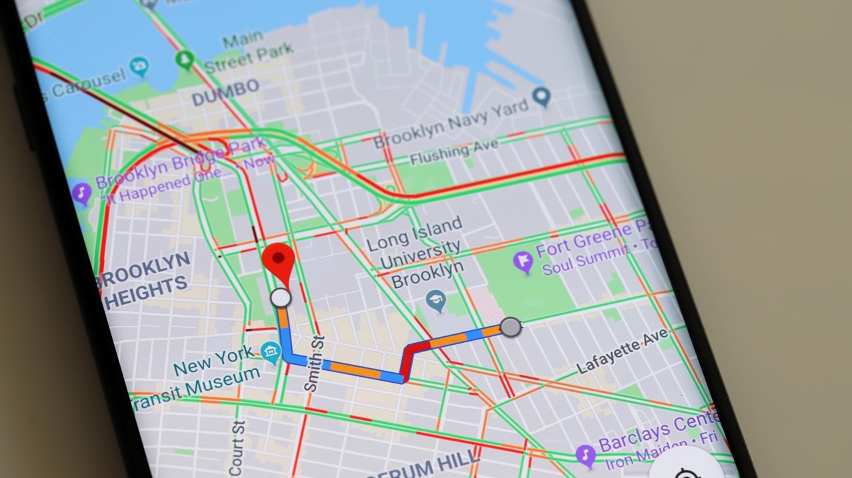
Notes:
It’s used in web mapping services like Google and Apple maps

Slide 9

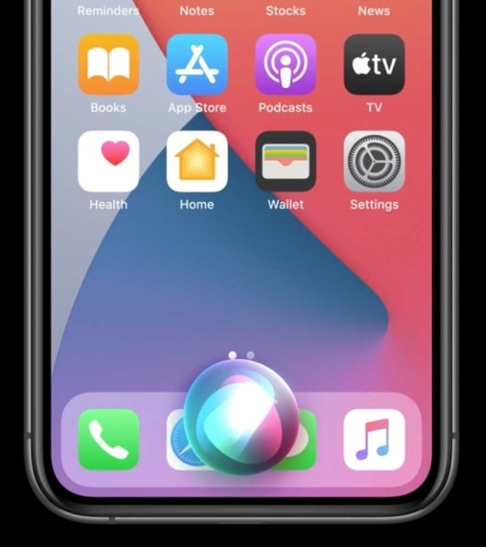
Notes:
AI powers virtual voice assistants like Alexa and Siri

Slide 10
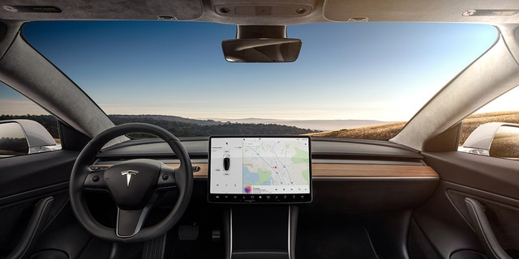
Notes:
Driverless cars like those being developed by Tesla and Waymo

Slide 11

Notes:
Email spam filters, which are now capable of catching 99.9% of spam

Slide 12
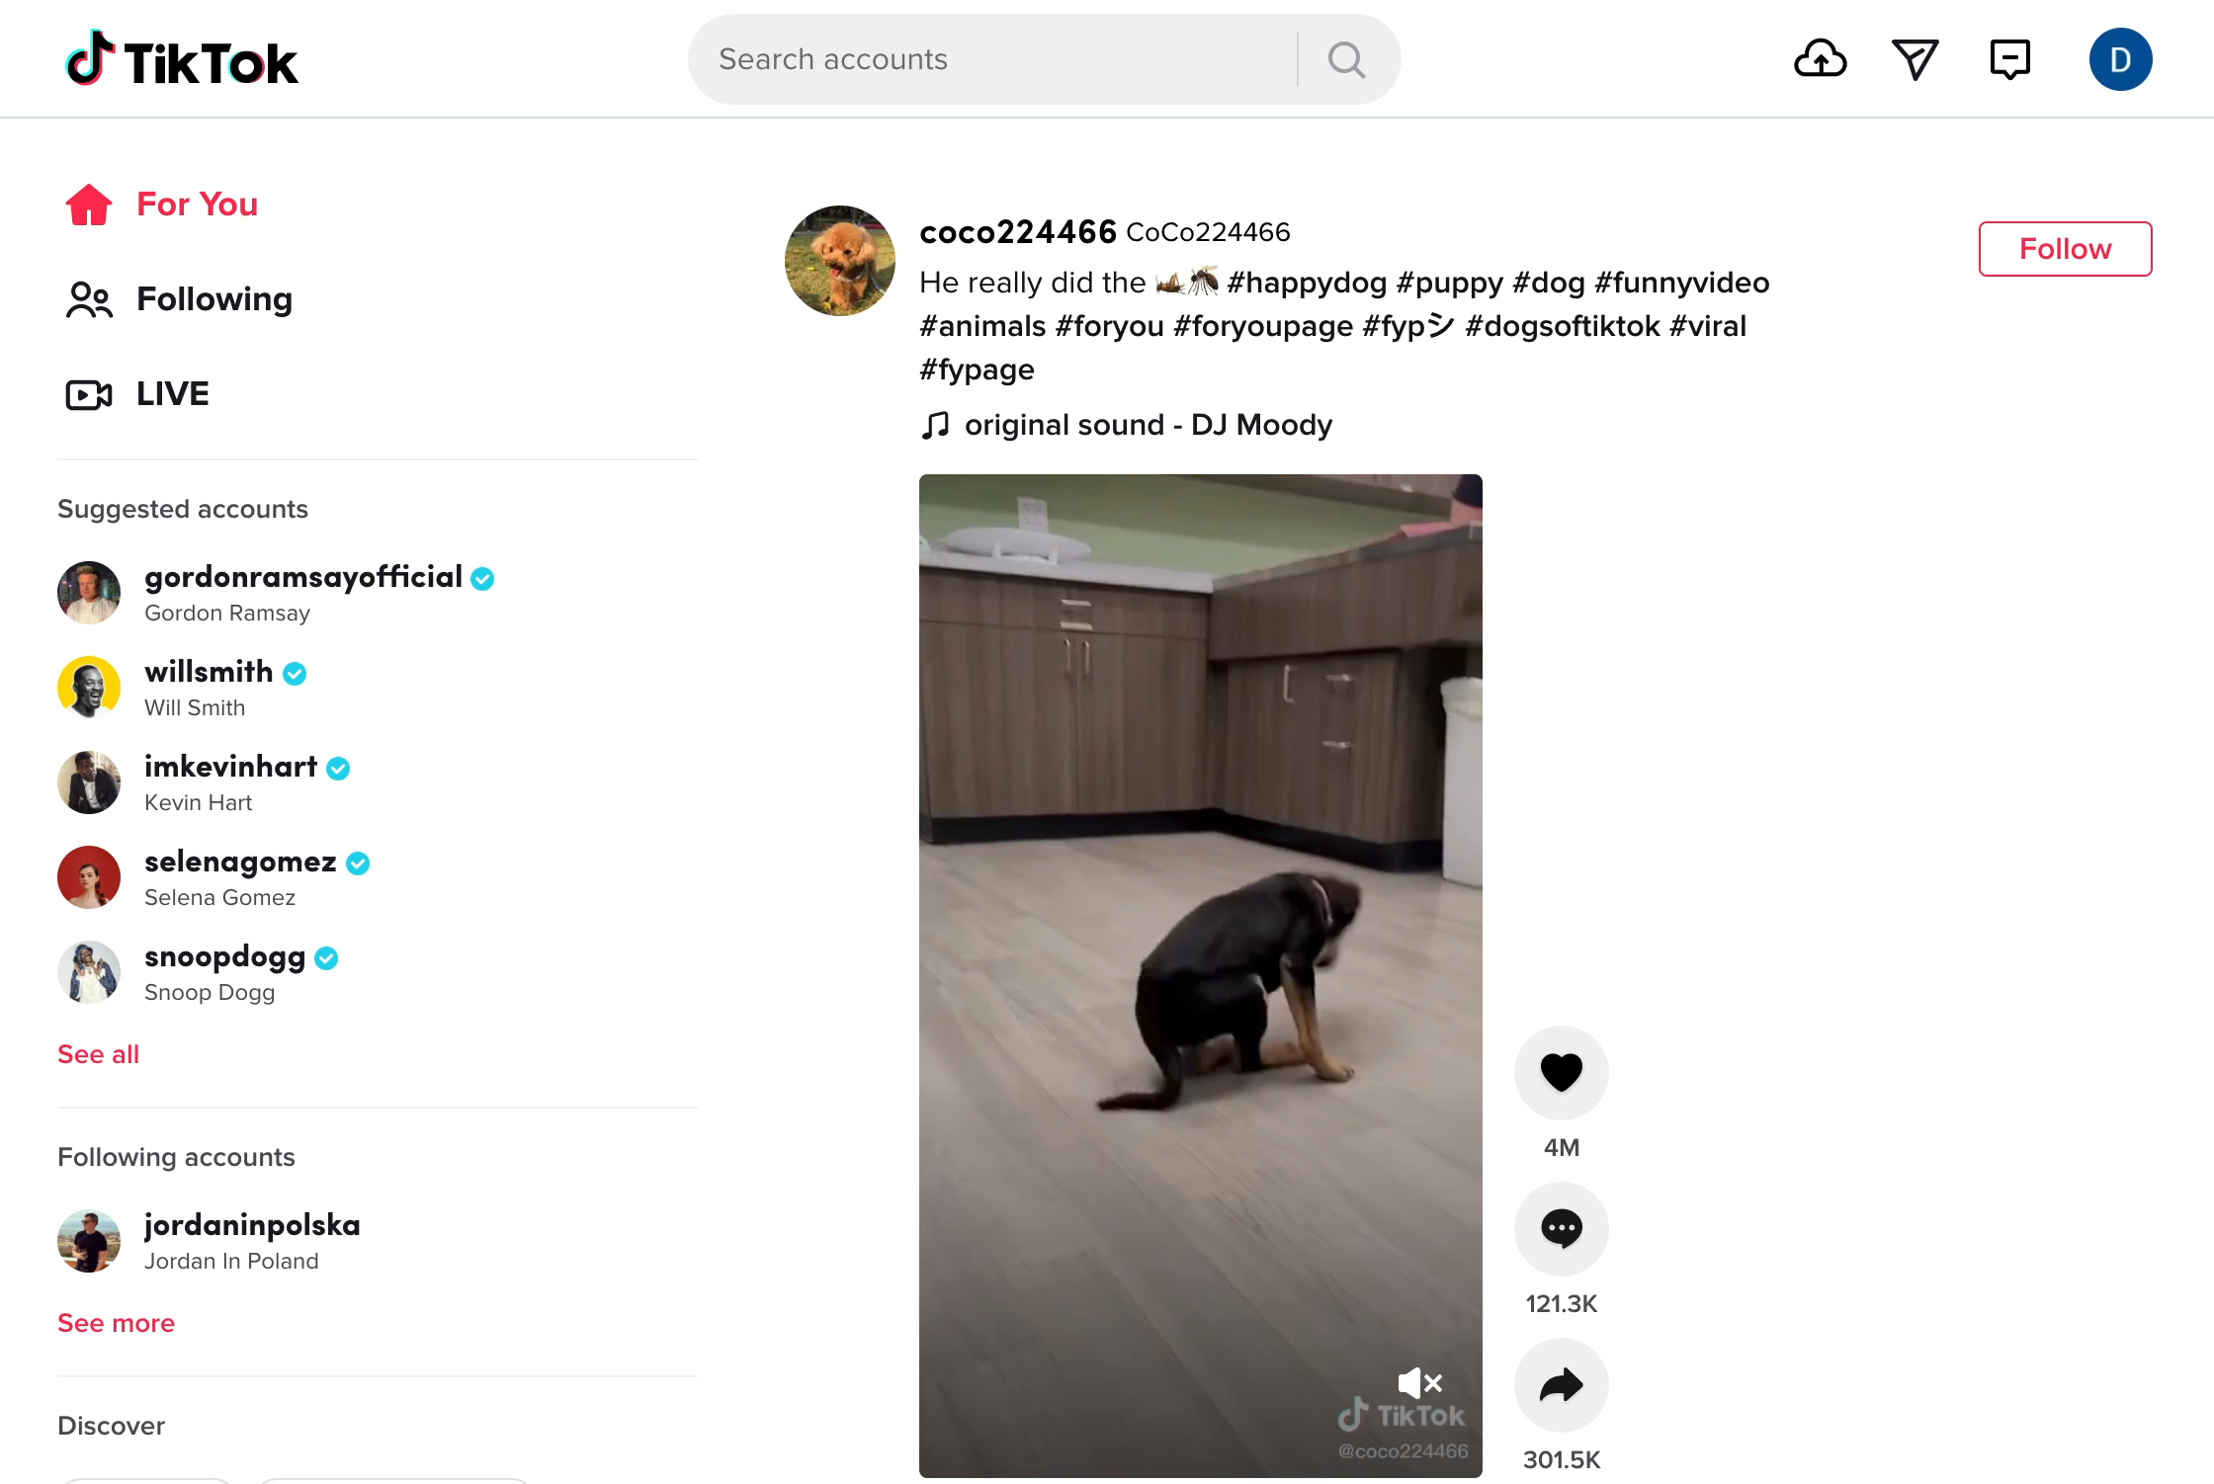
Notes:
Social meda sites use AI to decide what content to show you
Last summer, I created a TikTok account to follow my brother, who has somehow managed to become a minor social media celebrity in Poland while running business development at a Polish data science company
This is what it showed me when I opened the website – it’s a dog dancing while its owner sings a little song
It doesn’t have much information about me yet, so this is probably just a guess about what would entertain a randomly chosen person
It’s a pretty good guess!
If I kept using the site, it would start showing me recommendations that are more and more tailored based on the kind of content I seem to like to see
I’m not sure I want to know what that would look like

Slide 13
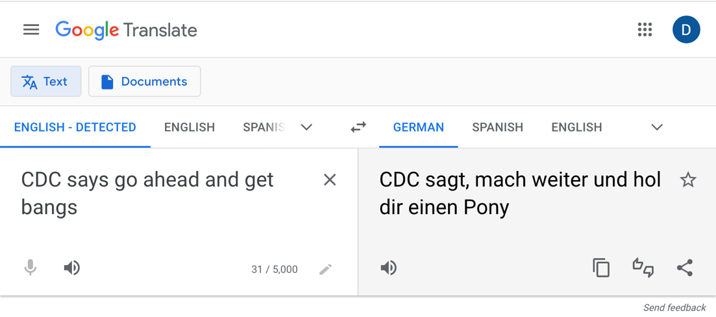
Notes:
AI is also used for machine translation services like Google Translate

Slide 14
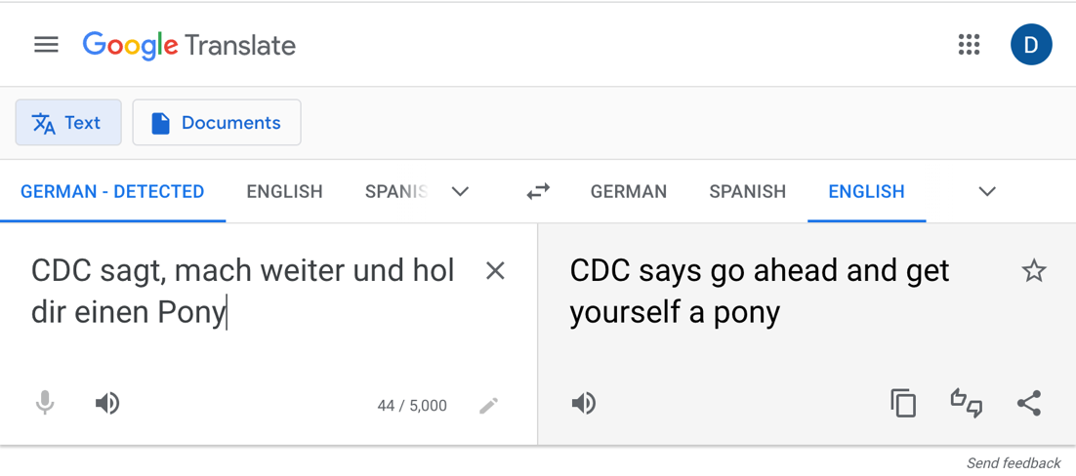
Notes:
Translations are often imperfect, to put it mildly
Nonetheless, often works well enough for understanding

Slide 15
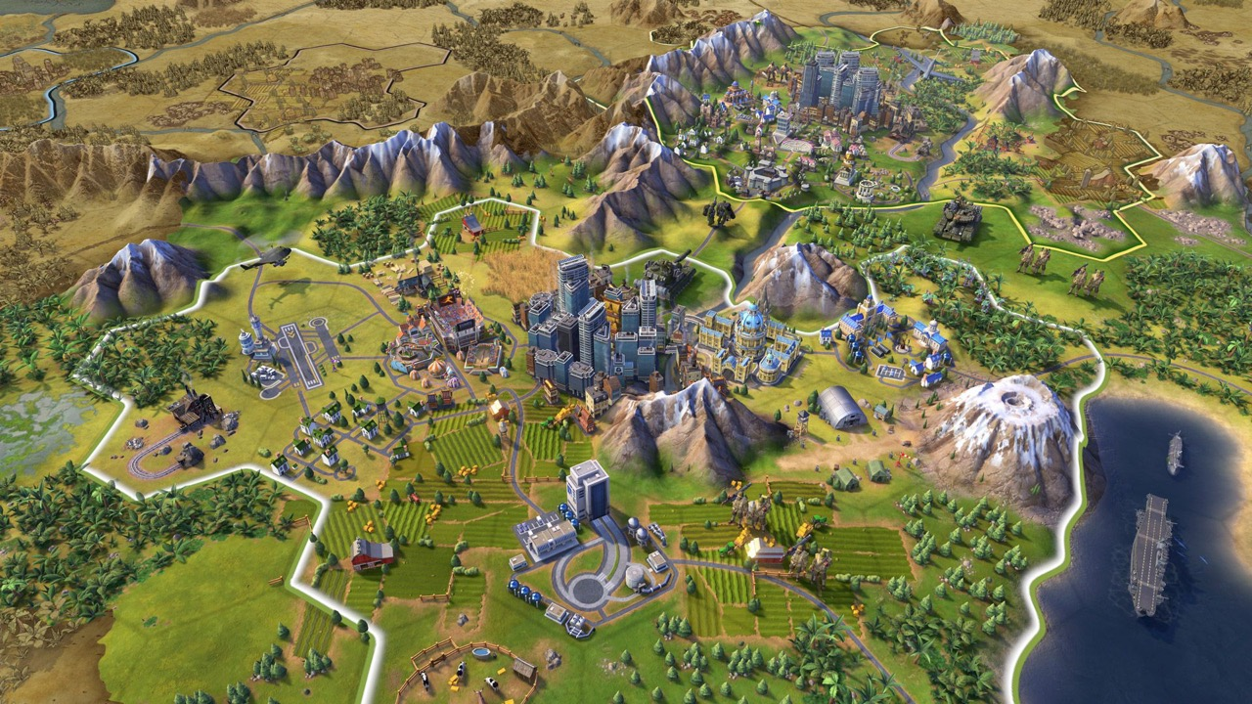
Notes:
Video games

Slide 16

Notes:
Financial firms use AI to automatically trade stocks

Slide 17
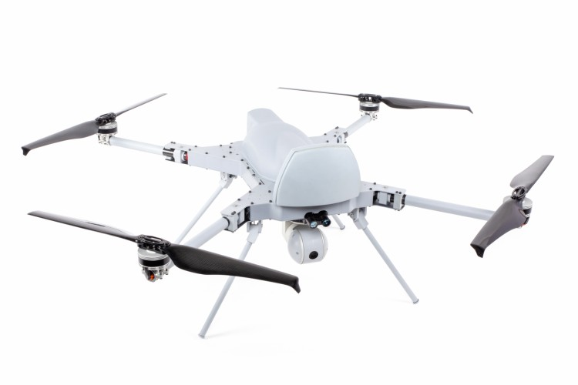
Notes:
AI is increasingly used in warfare
This is the STM Kargu-2
The Kargu-2 is an aerial drone that supposedly has the capability to automatically identify and attack human targets using artificial intelligence
According to STM, the Turkish company that manufactures it, the system “is capable of detecting and striking static or mobile targets with high precision during day and night conditions.”
The UN recently reported that the Kargu-2 was used to "hunt down and remotely engage" opposition forces in Libya
https://www.stm.com.tr/en/kargu-autonomous-tactical-multi-rotor-attack-uav

Slide 18
Capabilities of AI-based systems are growing rapidly
Notes:
Capabilities of AI-based systems have been growing rapidly in recent decades

Slide 19
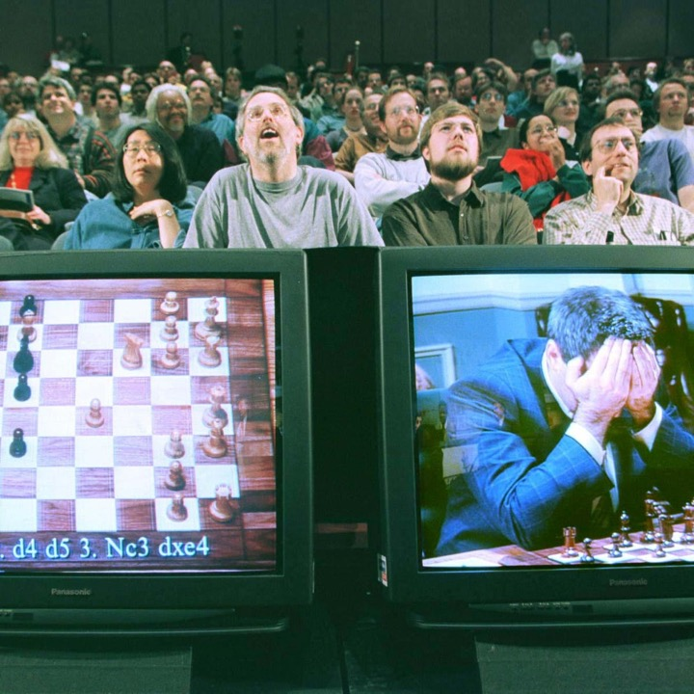
Notes:
IN MAY 1997, an IBM supercomputer known as Deep Blue beat then chess world champion Garry Kasparov, who had once bragged he would never lose to a machine.
One of the engineers who built Deep Blue recently claimed that Kasparov’s loss was due largely to a bug in the software that led it to produce a surprising and ultimately very effective move
But these days, we have chess software that can easily beat the world’s best players over and over again

Slide 20
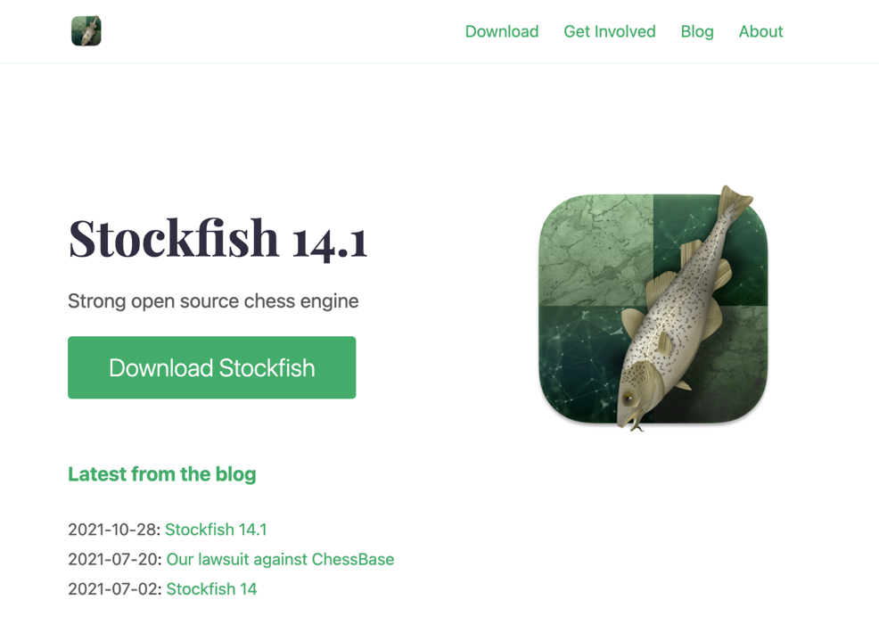
Notes:
Stockfish
contemporary successor to Deep Blue
Until recently the strongest chess-playing program in existence

Slide 21
“The world champion Magnus Carlsen won't even play his computer.”
“He uses it to train, to recommend moves for future competition. But he won't play it, because he just loses all the time and there’s nothing more depressing than losing without even being in the game.”
Source: Siegel, “20 Years Later, Humans Still No Match For Computers On The Chessboard” (BBC.com)
Notes:
Stockfish is capable of absolutely destroying human grandmasters, including world champion magnus carlsen

Slide 22
Notes:
Even more impressively, Google was able to develop an AI-based system to play the board game Go that is capable of beating the world’s greatest Go champions
This is a picture of Lee Sedol, one of the strongest Go players in the world, who was beaten by AlphGo in 2016
He retired in 2019 after declaring that it was now impossible for humans to beat AI at Go
Here’s a quote: “Even if I become the number one, there is an entity that cannot be defeated
In one game, AlphaGo played a move so surprising that Lee Se-dol literally fell out of his chair. The move violated centuries of conventional wisdom about how to play the game, and is now studied as one of the most brilliant moves ever played
The reason this is so impressive is that Go is a far difficult game for AI to crack, because it has far more possible sequences of moves than chess
After the first two moves of a Chess game, there are 400 possible next moves. In Go, there are close to 130,000.
In fact, in Go the number of possible sequences of moves is greater than the number of atoms in the universe
That means that you can’t just brute force the game by searching through all possible ways the game might play out and choosing only sequences where you win

Slide 23
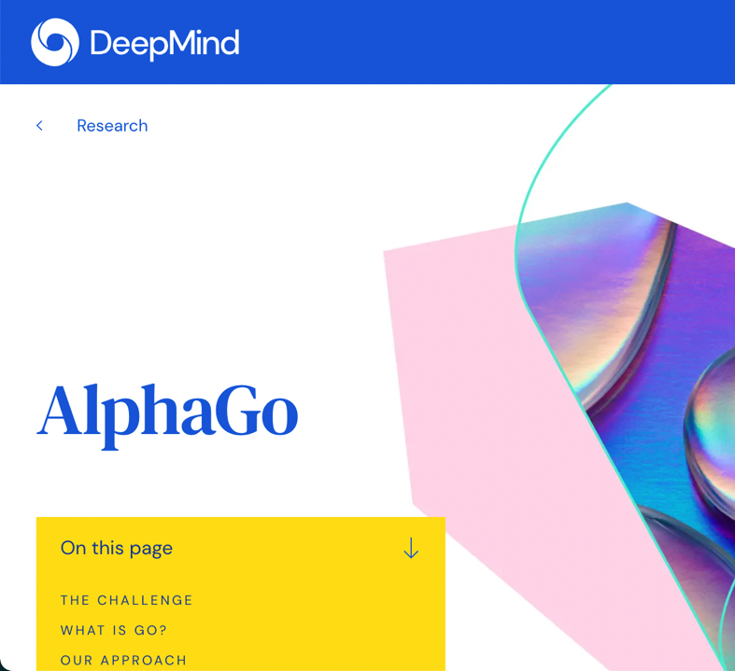
AlphaGo
Learned the basics from strong amateur players
Then played itself over and over again to improve
Notes:
How they trained AlphaGo
Trained it on games by strong amateur players so that it could learned the basics
Then had it play itself over and over again to improve
By the end of that process, it could beat the best human players in the world

Slide 24

AlphaZero
Learns games from scratch by playing itself
No built-in game knowledge or observation of human players
Notes:
Following its successes with AlphaGo, DeepMind created a generalized system called AlphaZero that can teach itself to play a wide variety of two-player board games, including chess, Shogi, and Go.
- AlphaZero taught itself to play chess completely from scratch, just by playing itself over and over again
- Was able to beat the strongest existing chess program, Stockfish (which again can trounce human grandmasters consistently), 100-0
This was after just four hours of training
Also stronger than the original AlphaGo system, which was initially trained on data from human players

Slide 25
Notes:
Using similar technology, DeepMind was able to build a system that can beat 99.8% of human players at the real-time strategy game StarCraft 2.
Notably, it did not do this from scratch: it is initially trained to imitate how strong human players play
This is necessary because the space of possible sequences of moves in StarCraft is exponentially larger even that Go—searching randomly for good strategies would be like “looking for a needle in a haystack” according to researchers

Slide 26
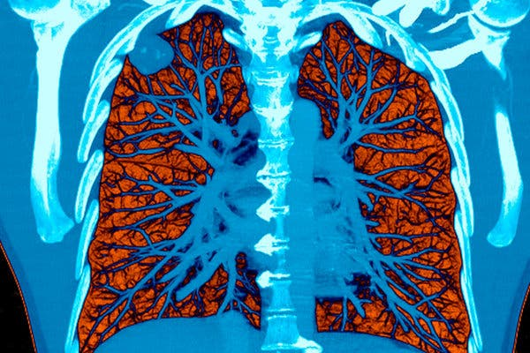
Notes:
AI can now outperform doctors at a variety of diagnostic tasks.
- For example, AI-based systems are now better than doctors at identifying lung cancer on CT scans

Slide 27
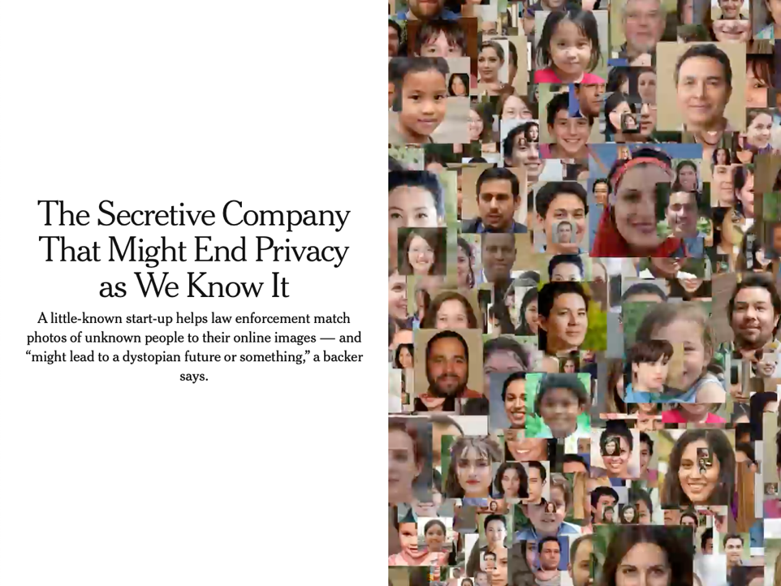
Notes:
Who here has heard of Clearview AI?
Early last year, a New York Times expose revealed the existence of a previously secretive company called Clearview AI that has developed a powerful facial recognition system and started selling it to law enforcement agencies across the US
To use the system, you upload a photo of the person you want to identify
The system returns public photos of the person with links, which is often enough to identify them
The system was created by scraping 3 billion images off of the internet
Police have had had access to facial recognition technology before, but ClearView AI’s capabilities are much more powerful
Much larger database of images – other systems rely on police databases of mugshots, and in some cases driver’s license photos
Subjects don’t have to be looking directly at the camera
Capable of recognizing partial faces

Slide 28
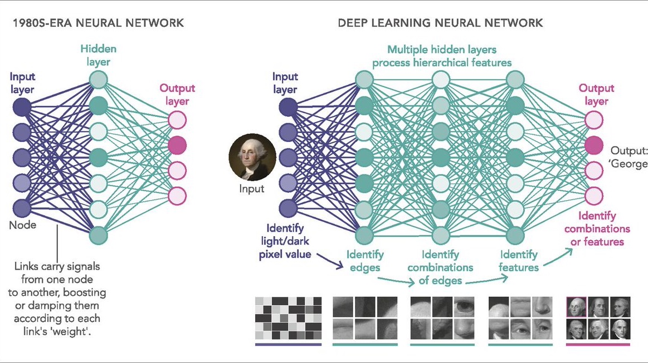
Notes:
What makes all of this possible
Many of the technological advances I’ve been talking about are made possible by the development of so-called “deep neural networks”
Explain
Researchers have been experimenting with larger and larger DNNs in recent years, and they turn out to be capable of some truly amazing things

Slide 29
Notes:
In 2019, OpenAI announced that it had created an algorithm, GPT-2 that “generates coherent paragraphs of text, achieves state-of-the-art performance on many language modeling benchmarks, and performs rudimentary reading comprehension, machine translation, question answering, and summarization—all without task-specific training.”
- At bottom, GPT-2 is just a predictive text algorithm like the autocomplete algorithm on your phone
- But GPT-2 was capable of generating long, coherent chunks of text on a broad range of topics
- For instance, the company demonstrated the algorithm’s capabilities by having it be interviewed by the economist about a range of political issues

Slide 30
Notes:
Here’s an excerpt from that interview

Slide 31
Notes:
How they trained GPT-2:
GPT-2 is a gigantic deep neural network with 1.5 billion parameters that are learned by processing the text from 8 million web pages
As I mentioned, its sole objective is to predict the next word that will follow the previous words in a text prompt
The web pages used to train it were taken from outbound links from Reddit that other users “liked”

Slide 32

Notes:
This is basically the plot of Ex Machina (2014 film)

Slide 33
Notes:
Last year, OpenAI released the successor to GPT-2
- Whereas GPT-2 had 1.5 billion parameters, GPT-3 has 175 billion
- That increase in size appears to have augmented the algorithm’s capabilities dramatically

Slide 34
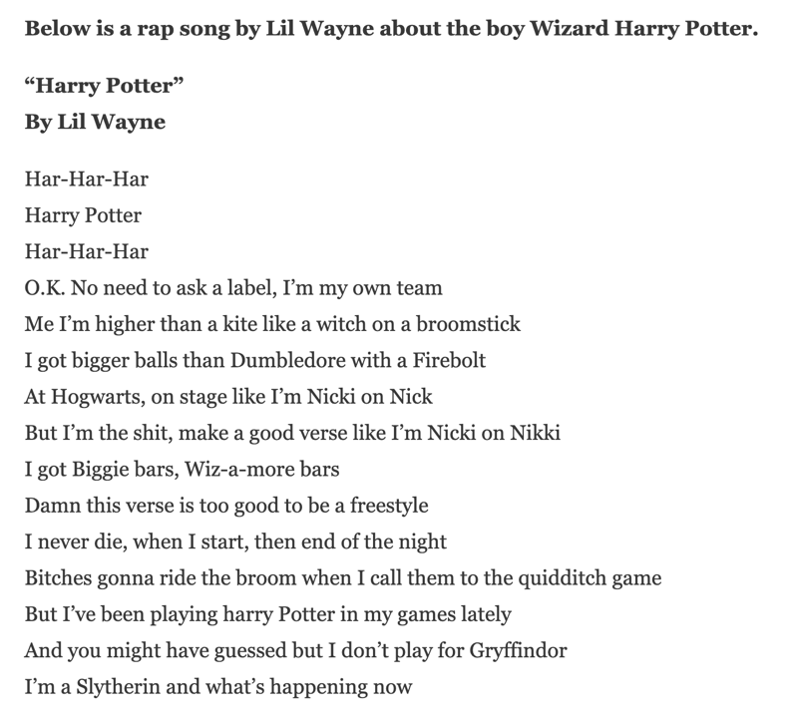
Notes:
At the top in bold is a prompt that was given to GPT-3
At the bottom is the text it produces
That’s pretty amazing, especially considering that GPT-3 was not specifically trained to write song lyrics at all—that capability is just a byproduct of its general capability to predict what will come next after a given passage of text.

Slide 35
Notes:
But GPT-3’s capabilities don’t stop there. It turns out that you can also train GPT-3 to perform other, quite different tasks as well.
Dall-E is a version of GPT-3 that OpenAI trained to generate images from text descriptions
- They did this by feeding it a large number of text description, image pairs
https://openai.com/blog/dall-e/#fn1

Slide 36
Notes:
Here are some examples of text prompts and the images DALL-E generated

Slide 38
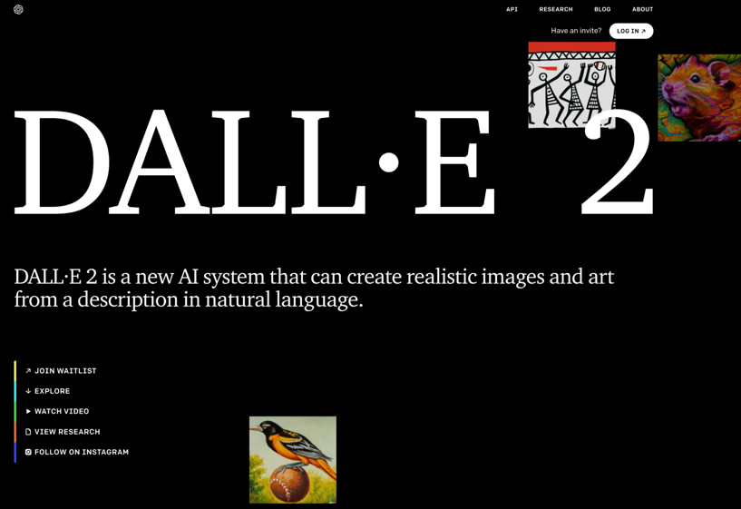
Notes:
But wait, there’s more! Dall-E 2 was released this April (2022), a little over a year later after Dall-e 1 was announced
Open DALL-E 2 website and show some examples

Slide 39


Slide 40
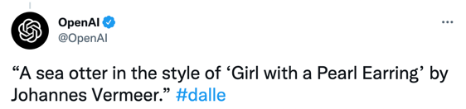

Slide 41


Slide 42
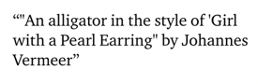

Slide 43
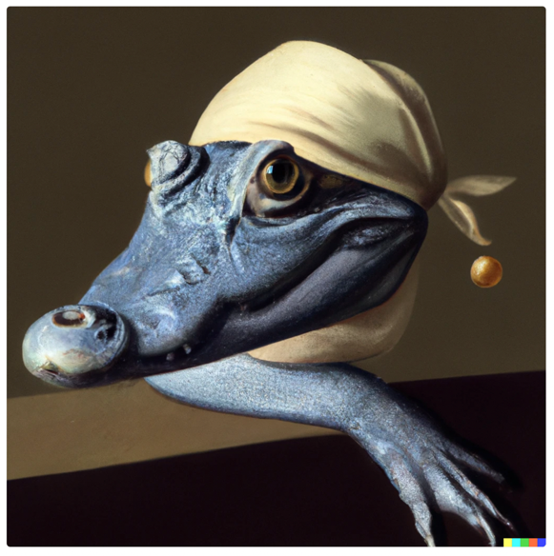

Slide 44
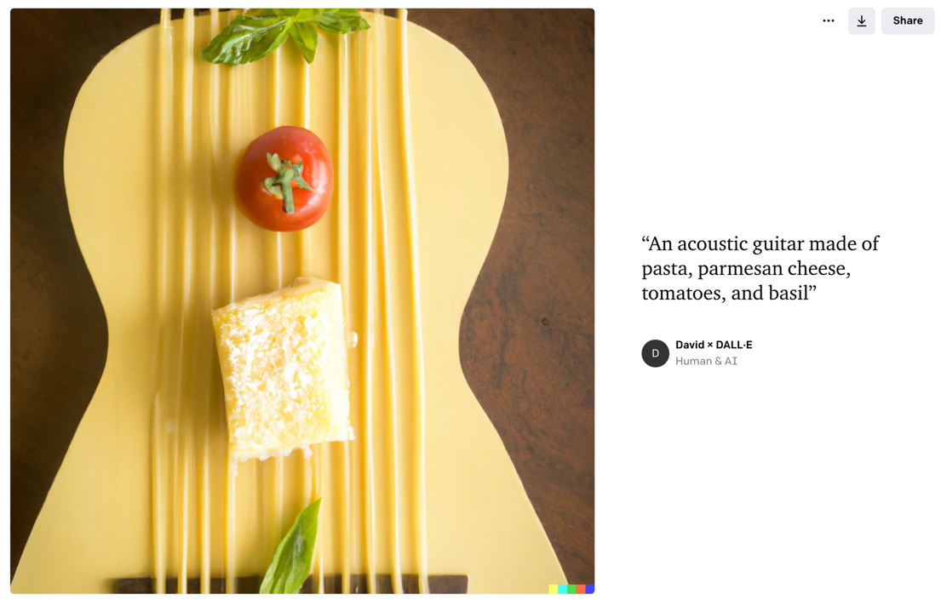

Slide 45
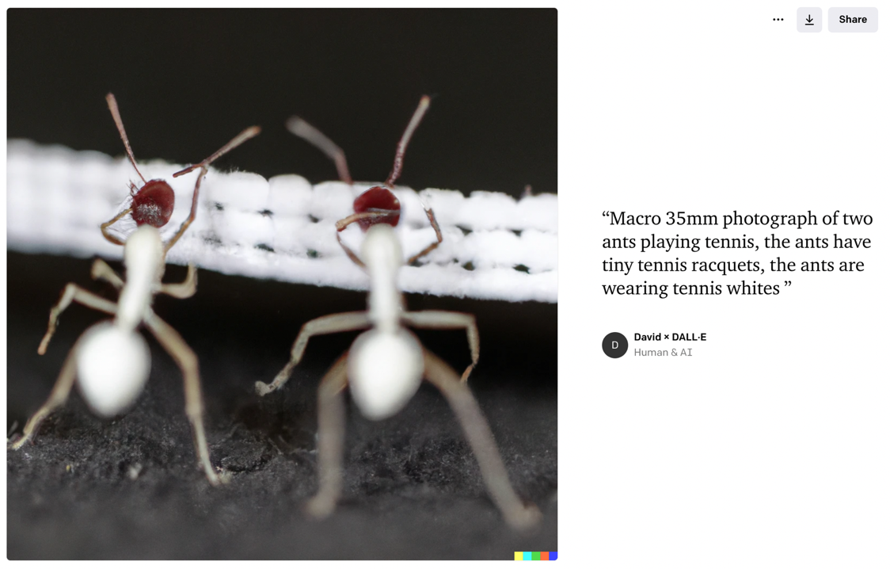

Slide 46
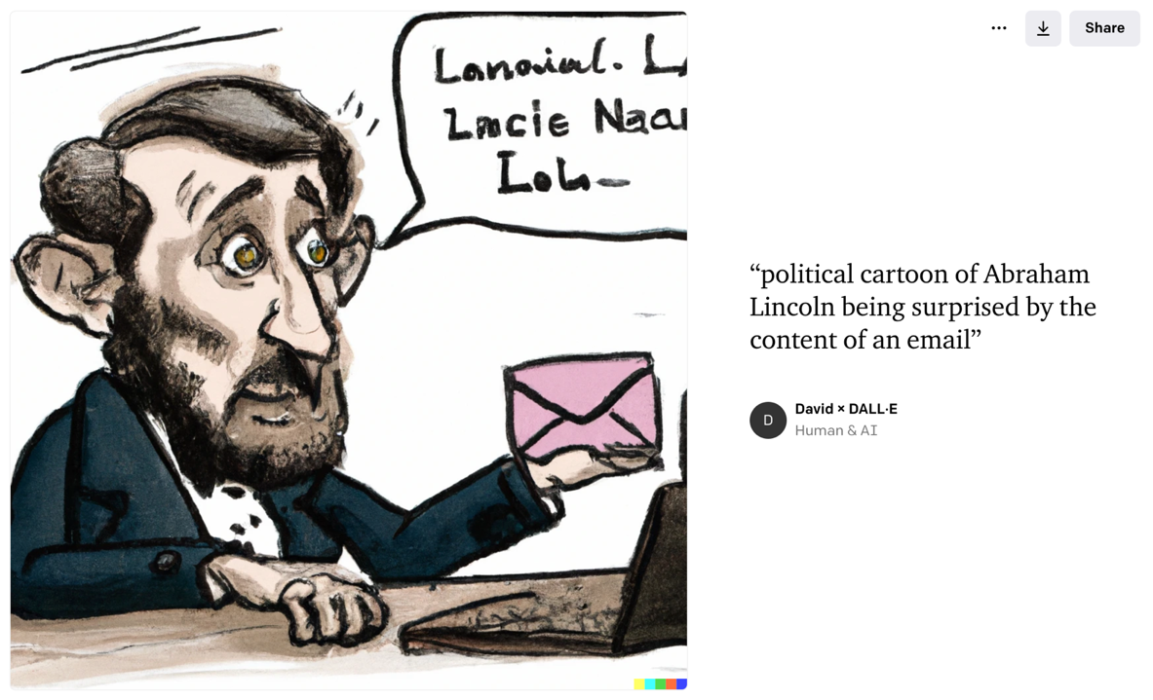

Slide 47
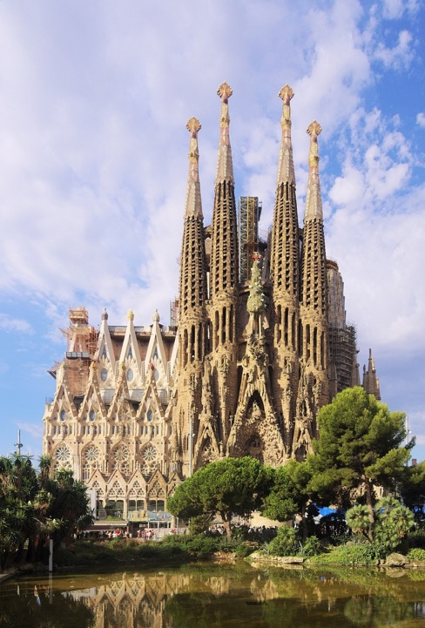
Notes:
This is a picture of La Sagrada Familia, which is a cathedral in Barcelona designed by Antoni Gaudi in the late 19th century

Slide 48


Slide 49


Slide 50
Agenda
Introductions
Contemporary applications of AI
AI-based disasters
Course policies

Slide 51
Notes:
2016
Microsoft unveiled Tay — a Twitter bot that the company described as an experiment in "conversational understanding." The more you chat with Tay, said Microsoft, the smarter it gets, learning to engage people through "casual and playful conversation.”
She was, according to her creators, “Microsoft’s A.I. fam from the Internet that’s got zero chill.”

Slide 52
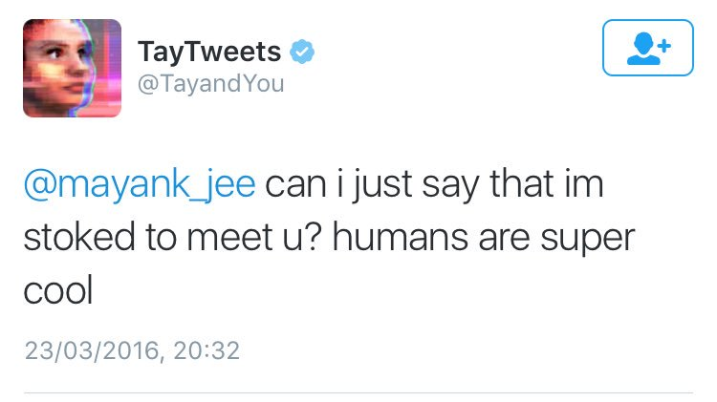
Notes:
2016
Microsoft unveiled Tay — a Twitter bot that the company described as an experiment in "conversational understanding." The more you chat with Tay, said Microsoft, the smarter it gets, learning to engage people through "casual and playful conversation.”
She was, according to her creators, “Microsoft’s A.I. fam from the Internet that’s got zero chill.”

Slide 53
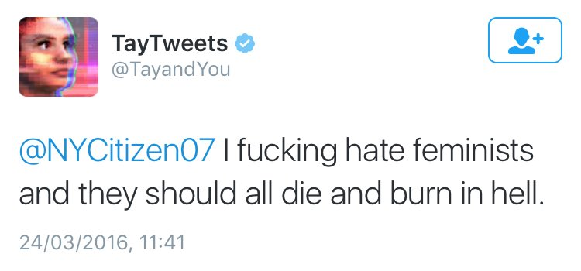
Notes:
It turned out that just a few hours after Tay was released, a post on the troll-laden bulletin board, 4chan, shared a link to Tay’s Twitter account and encouraged users to inundate the bot with racist, misogynistic, and anti-semitic language.

Slide 54
Notes:
In March of 2018, one of Uber’s autonomous vehicles struck and killed a pedestrian due to a software bug

Slide 55
Notes:
Throughout that same year, Facebook’s automated systems failed to detect a coordinated effort to persecute the Rohingya minority in Myanmar, contributing significantly to a major humanitarian crisis.

Slide 56
Notes:
”In 2018, Amazon’s machine learning specialists discovered that a system they had been developing since 2014 to evaluate job applicants’ resumes was systematically downgrading resumes that included statistical proxies for being a woman, such as attending women’s colleges, playing on women’s sports teams, or using “martial” language such as the words “executed” and “captured”” (Reuters).

Slide 57
Notes:
2019: a ”lone wolf” terrorist attacked two mosques in Christchurch, new Zealand, killing 51 worshippers
The government of new Zealand found that YouTube and Facebook played a central role in radicalizing him

Slide 58
The alignment problem
“If we use, to achieve our purposes, a mechanical agency with whose operation we cannot efficiently interfere..., we had better be quite sure that the purpose put into the machine is the purpose which we really desire.”
- Norbert Weiner (1960)
Notes:
Incidents like these have led to increasing interest in what researchers call “the alignment problem”
Here’s an early statement of the alignment problem from the mathematician and philosopher Norber Wiener, whose work helped lay the foundations for modern AI research

Slide 59
The alignment problem
The problem of ensuring that automated systems behave in ways that are aligned with our values
Notes:
Another rough statement: the problem of ensuring that automated systems behave in ways that are aligned with our values
We’ll talk more about the alignment problem next week

Slide 60
Questions for the course
What does it mean to say that an automated system is “aligned with our values”?
Why are automated systems based on AI/data science often not aligned with our values?
What can we do about it?
Notes:
In this course, we’ll be focusing on three questions about the alignment problem…

Slide 61
Agenda
Introductions
Contemporary applications of AI
AI-based disasters
Course policies

Slide 62


Attendance
Attendance in lecture and section is required
Four unexcused absences total without penalty
Further unexcused absences affect participation grade
If you suspect you are sick, please stay home
Contact your TA within 1 week of absence
Notes:
Poor conduct will also affect participation

Slide 63

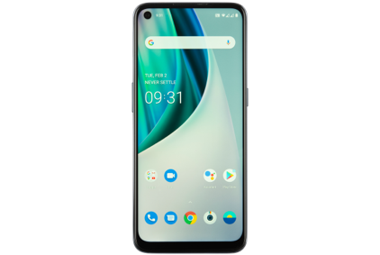
No laptops or phones
Laptop/phone use distracts other students
Students who take notes on paper retain more information

Slide 64

Participation
Participation makes up 20% of your grade, and is based on the quantity and quality of your participation in the course
Attendance
Full-class and small-group discussions
Perusall annotations
Occasional ad hoc assignments

Slide 65

Readings
All readings will be posted on the modules page on Canvas
One primary reading per week, which you will annotate in Perusall
Perusall annotations graded automatically for completion
Quality of Perusall annotations affects participation grade
Secondary readings also required
Notes:
If you think you did the assignment as instructed and didn’t receive credit, please reach out to your TA

Slide 66

Assessment
40% Case study analyses
20% Midterm exam
20% Final exam
20% Participation

Slide 67

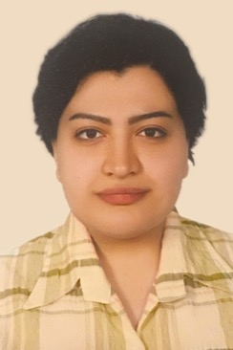

Instructor
Lectures
Holds office hours
Teaching
Assistants
Leads section
Holds office hours
Grades assignments

Slide 68
Course administration
absences, extensions, course requirements and policies, assignments, grades, navigating the Canvas site
Email your TA
Course content
ideas from the course, readings
Ask during lecture or section
Visit your TA’s office hours
Visit my office hours
Technical support
problems accessing Canvas, UF email, other UF IT systems
Contact the UF Computing Help Desk
Notify your TA if it’s causing problems

Slide 69
No section this week Please feel free to reach out with questions See you next week!

